Slide 1


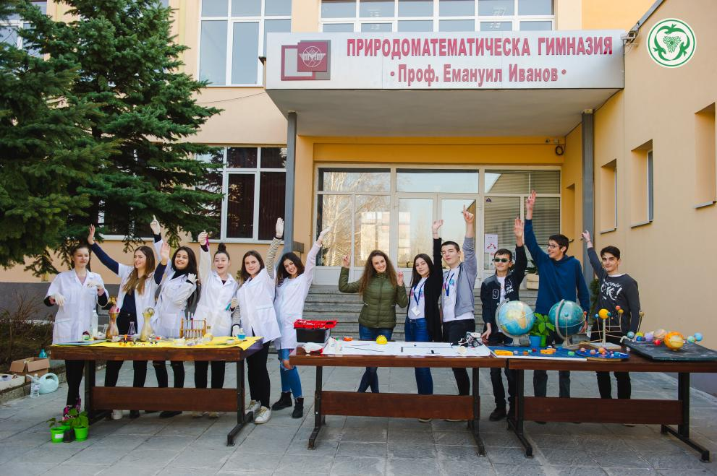





Национален форум
„Училищата с иновации за бъдещето“
Национален дворец на културата София
21 октомври 2022

Slide 2
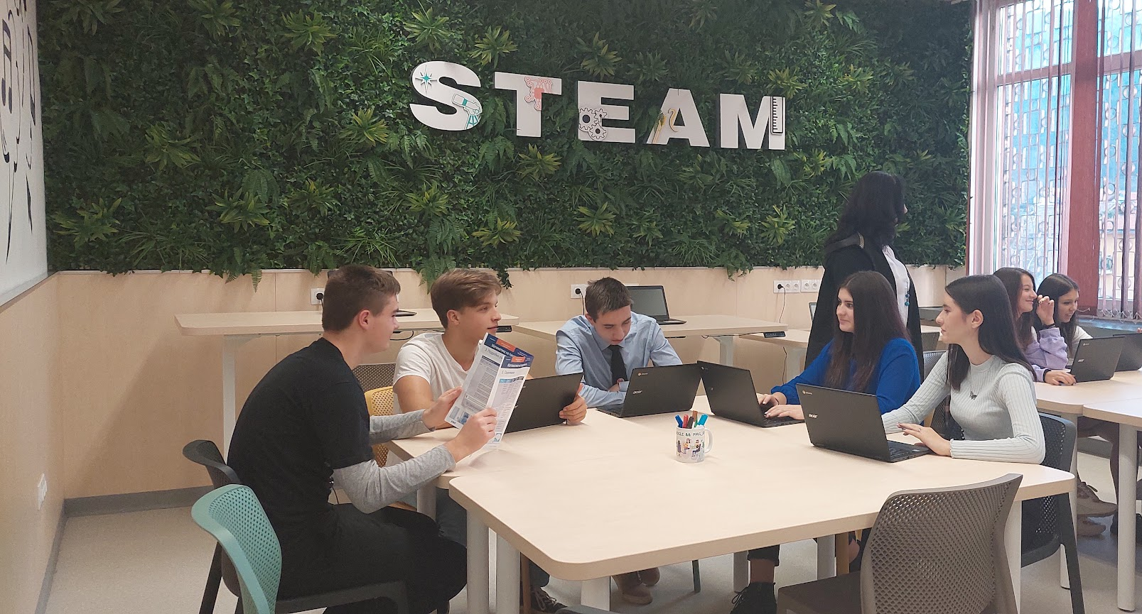
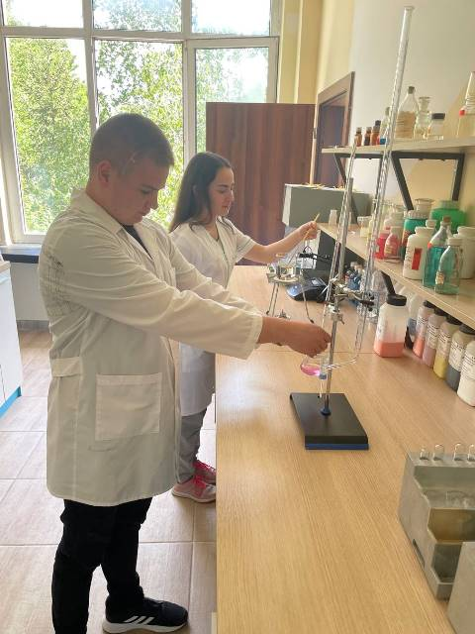
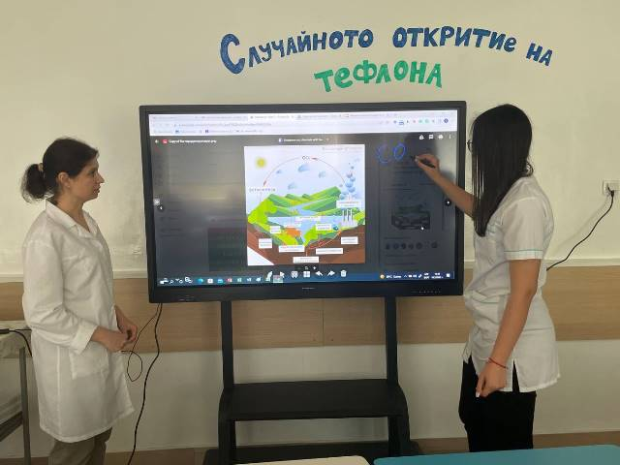
ПМГ „Проф. Емануил Иванов“
НИЕ И ГЛАСЪТ НА ВРЕМЕТО
Дейност 1. Организация на работата в училище – оптимизация и
дигитализация
Блокова организация на учебните занимания
Промяна на ролята на класния ръководител от администратор към ментор
Споделено търсене на решения при проблеми
Дейност 2. Утвърждаване на ролята на учителя като вдъхновител и ментор
Обучения на педагогическите специалисти
Акцент върху саморегулираното и социално-емоционално учене
Въвеждане на интегриран подход и интердисциплинарни връзки
Дейност 3. Фокусиране върху развитието на ученика като личност и утвърждаване на важната роля на родителите в образователния процес
Дейност 4. Промяна във физическата среда
Център по природни науки
Зона за дигитална креативност
Обособяване на кътове за почивка и разговори

Slide 3
Силвия Красимирова Георгиева
Природоматематическа гимназия
„Проф. Емануил Иванов“
гр. Кюстендил
общ. Кюстендил
обл. Кюстендил
s.georgieva@pmgkn.com
0894748075
Notes:
You can use this slide as your opening or closing slide. Should you choose to use it as a closing, make sure you review the main points of your presentation. One creative way to do that is by adding animations to the various graphics on a slide. This slide has 4 different graphics, and, when you view the slideshow, you will see that you can click to reveal the next graphic. Similarly, as you review the main topics in your presentation, you may want each point to show up when you are addressing that topic.
Add animation to images and graphics:
Select your image or graphic.
Click on the Animations tab.
Choose from the options. The animation for this slide is “Split”. The drop-down menu in the Animation section gives even more animations you can use.
If you have multiple graphics or images, you will see a number appear next to it that notes the order of the animations.
Note: You will want to choose the animations carefully. You do not want to make your audience dizzy from your presentation.

Slide 4
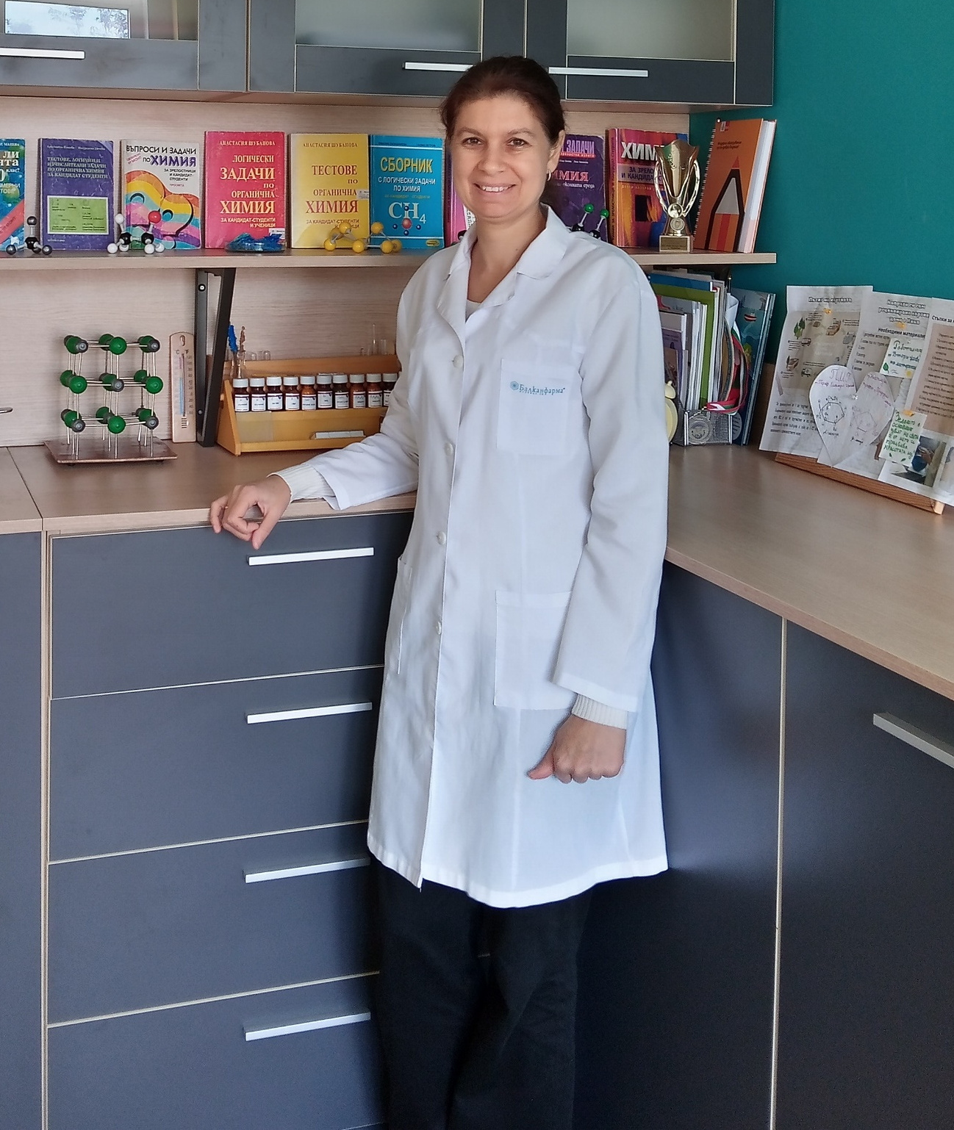
Старши учител по химия и ООС (VII – XII клас) и човекът и природата (V – VI клас)
10 години педагогически стаж
II професионалноквалификационна степен
Публикации
„От рецептата на баба до олеиновия сапун“- формиране на познавателния интерес и развитие на творческите търсения“, „Професионално образование“, 10/2019, автор
„Осмоза. Осмотично поведение на клетка" - използване на електронни приложения, облачни технологии и демонстриране на експерименти“, „Професионално образование“, 04/2020, съавтор
Notes:
After you’ve done your research, it’s time to put your presentation together. The first step in the process is to introduce the topic. This is a great time to connect your topic to something that your audience can relate. In other words, why should they listen to all the information you will be sharing in your research presentation? What is in it for them? You may also want to include a graphic or image to grab their attention.
Feel free to duplicate this slide by right-clicking on this slide in the slides pane to the left and select Duplicate Slide.
The next step in your presentation is to state your claim or topic clearly. Your teacher may even call this your thesis. As you state your thesis, you may find that this layout is not the best layout for your claim or topic. You can change the layout by clicking the drop-down menu next to the Layout in the Slides menu section. You can choose Two Content, Comparison, or Picture with Caption. Note: A different layout might change the look of the icons on this page.
You will also want to state your facts. You have done the research now share some of the interesting facts with your audience. Facts do not have to be boring; you can communicate facts in a variety of ways by going to the Insert Tab. In the Insert tab you can:
Insert pictures from your computer or online.
Add a chart
Create some SmartArt
Insert a variety of icons to help your facts come to life. Note: You can change the color of the icons by selecting the icon and then click on the Format tab and then Graphics Fill. From there, you will choose a color from the list or choose More Fill Colors to give you more options.
Since this research presentation is a result of your hard work and searching, you want to make sure you support the claims or points in your presentation with facts from your research findings. Make sure you give the author proper credit for helping you share your ideas. If one of your sources has a video that is relevant to your topic, you can add the video as added support. Keep in mind the length of the video and the amount of time you have for your presentation. For a 5 minute speech, the video should be no longer than 30 seconds.
Questions to consider:
How will you state the author of the source?
Will you need to cite the source on the slide?
What are some ways you can engage your audience so they feel like they are a part of the presentation? Some ideas to consider is by taking a quick poll like: by a show of hands, how many of you think school uniforms are a way to cut down on bullying? Another suggestion is to have them hold up a certain number of fingers to see if they agree or disagree. Finally, you can share a story that the audience can relate to that makes them laugh.
After all the applause, your audience may have some questions. Be prepared to answer some of their questions by making a list of questions you think they might ask. You may also want to share the presentation with them by providing the link to your presentation, if they want more information.

Slide 5
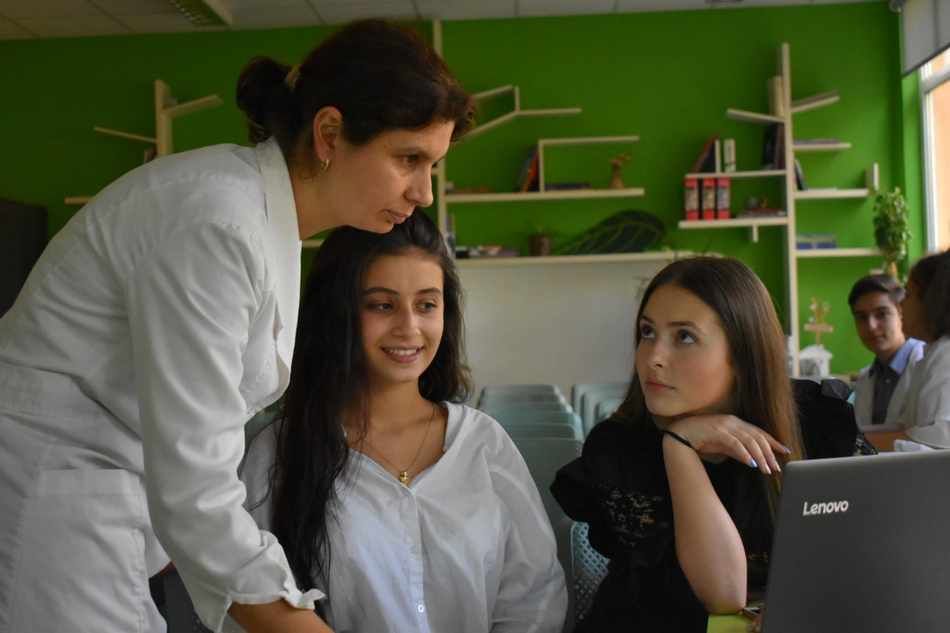
АКЦЕНТИ
в методите на преподаване
Проектно ориентирано обучение
Екипна работа/сътрудничество
Прилагане на компетентностнен подход
интегрирано междупредметно взаимодействие
практическа насоченост на обучението
ориентация към резултати
прилагане на иновативни подходи и практики в процеса на преподаване и учене
Notes:
Now, that you have narrowed your topic, you will want to organize your research in a structure that works. There are some common organizational patterns based on the kind of research you are doing.
Organizational Structures:
Cause and Effect- this kind of structure is great for explaining the causes and effects of a topic
Compare and Contrast- in this pattern you highlight the similarities and differences of the topic
Explain process- this structure is great for outlining a series of steps to follow;
Definition- if you want to make sure your audience understands what something is using illustrations, meanings, clarifying misconceptions, you may want to use this structure
Classification- a common organizational structure is grouping like topics or facts from the research together. For instance, in the internet safety about social media apps, you may organize the research where you look at each social media app one at a time

Slide 6

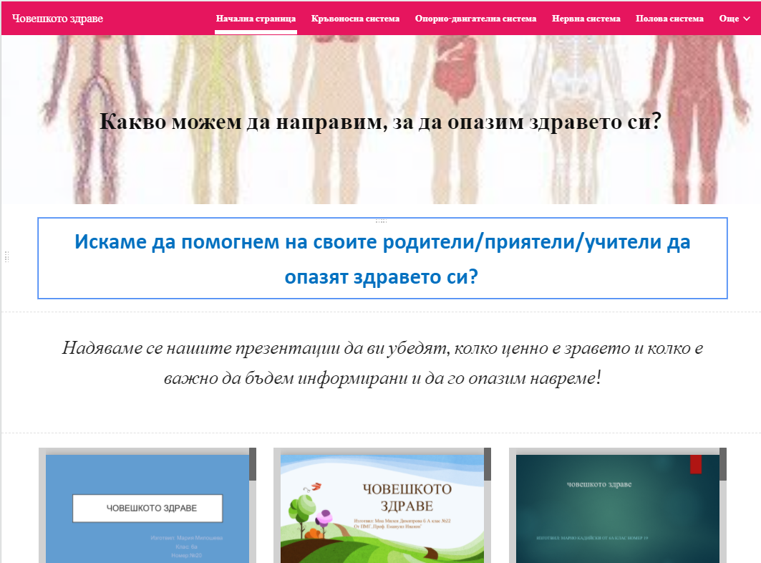

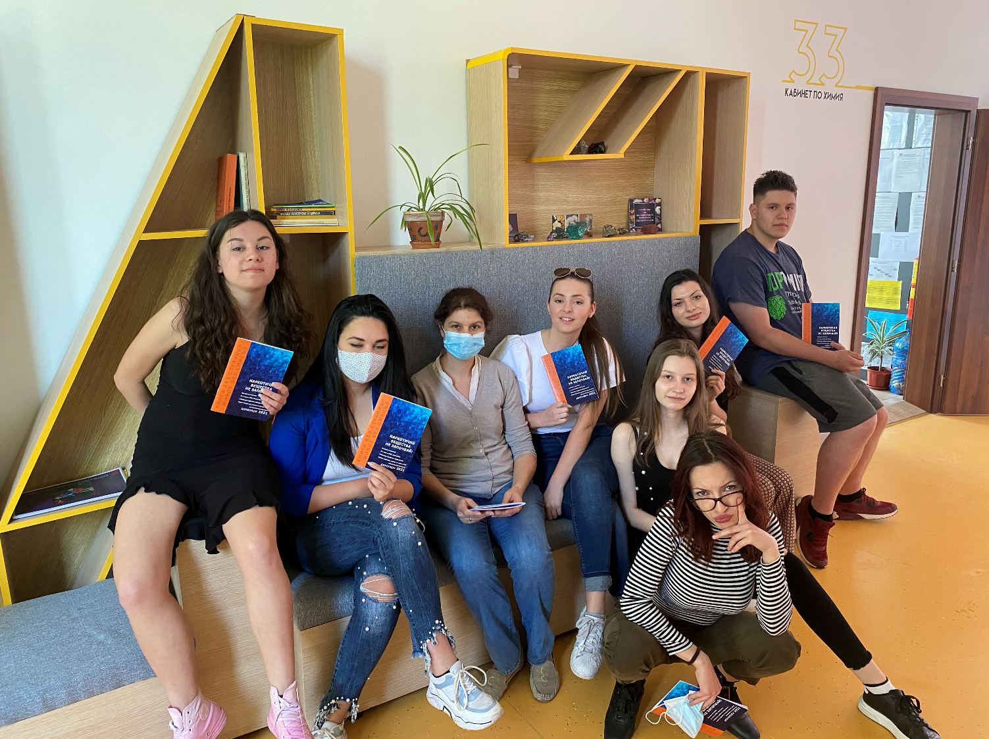
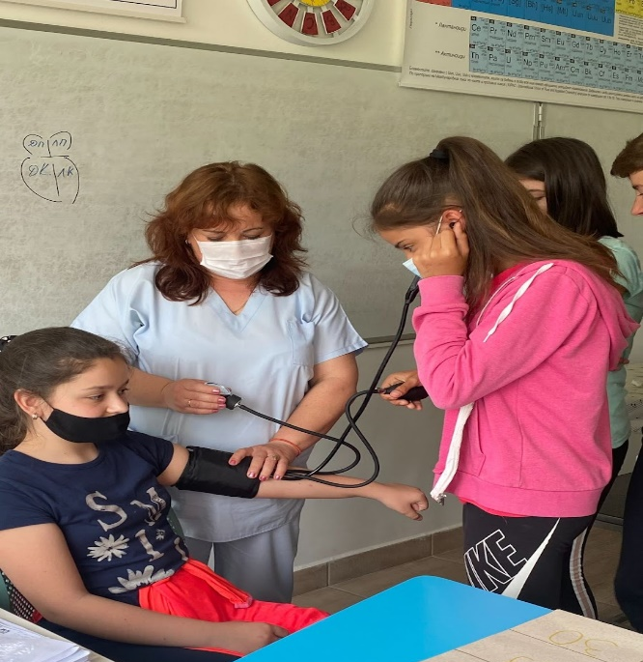
Интердисциплинарни уроци
(реализирани в учебната практика)
Човешкото здраве (6 клас)
човекът и природата
български език и литература
информационни технологии
Наркотични вещества.
„Не започвай!“ (12 клас)
химия и ООС
информационни технологии
гражданско образование
Notes:
When conducting research, it is easy to go to one source: Wikipedia. However, you need to include a variety of sources in your research. Consider the following sources:
Who can I interview to get more information on the topic?
Is the topic current and will it be relevant to my audience?
What articles, blogs, and magazines may have something related to my topic?
Is there a YouTube video on the topic? If so, what is it about?
What images can I find related to the topic?

Slide 7
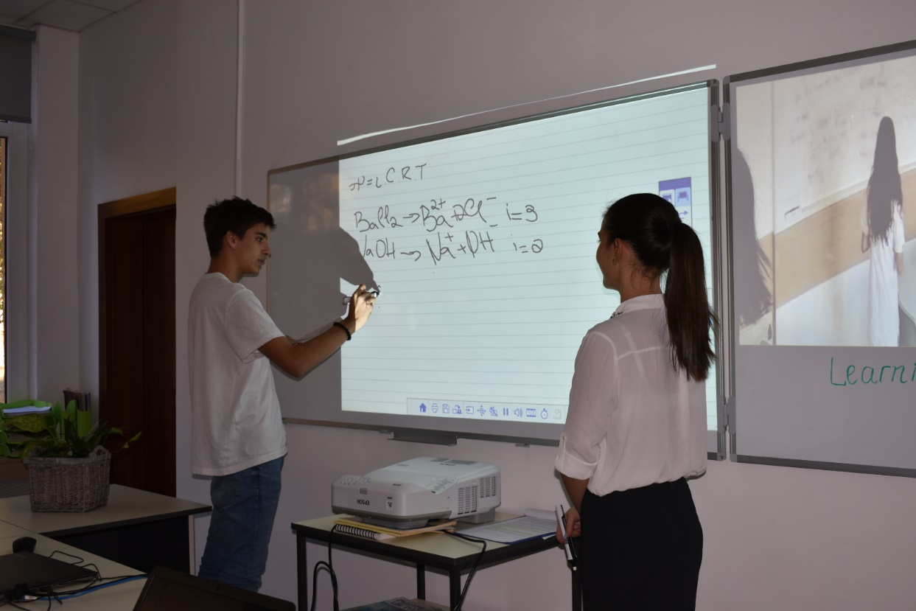
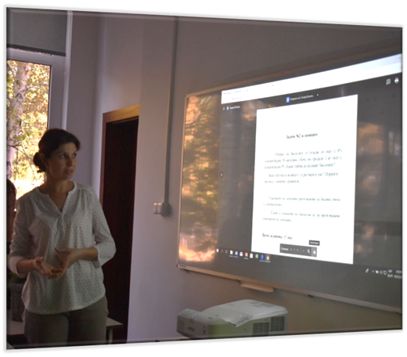
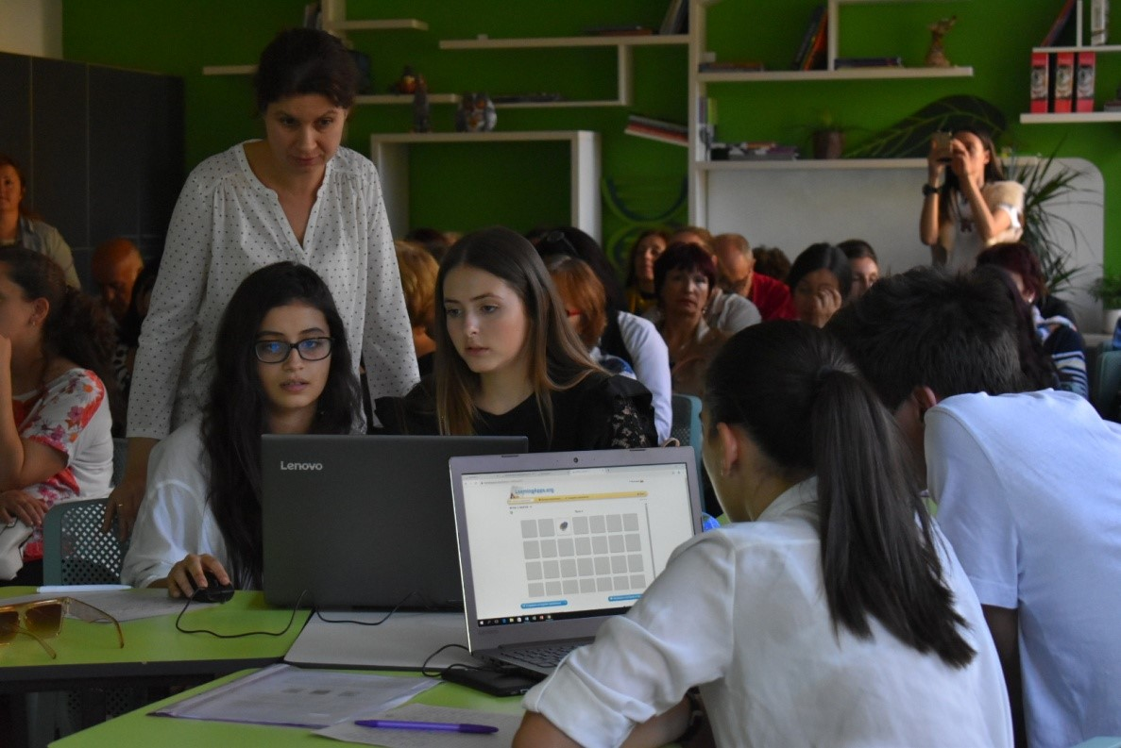
Интердисциплинарни уроци
(реализирани в учебната практика)
Осмоза. Осмотично поведение на клетка(10 клас)
биология и ЗО
химия и ООС
математика

Slide 8
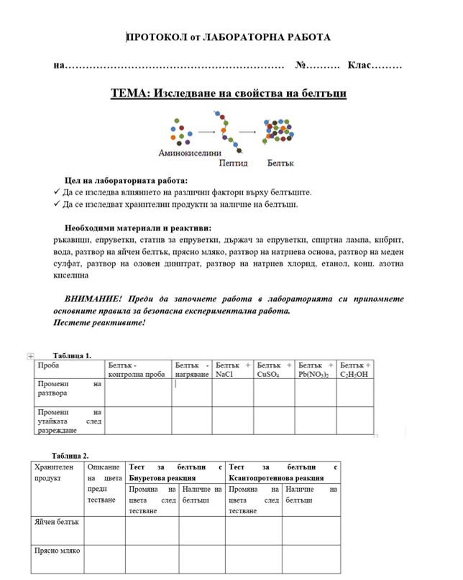
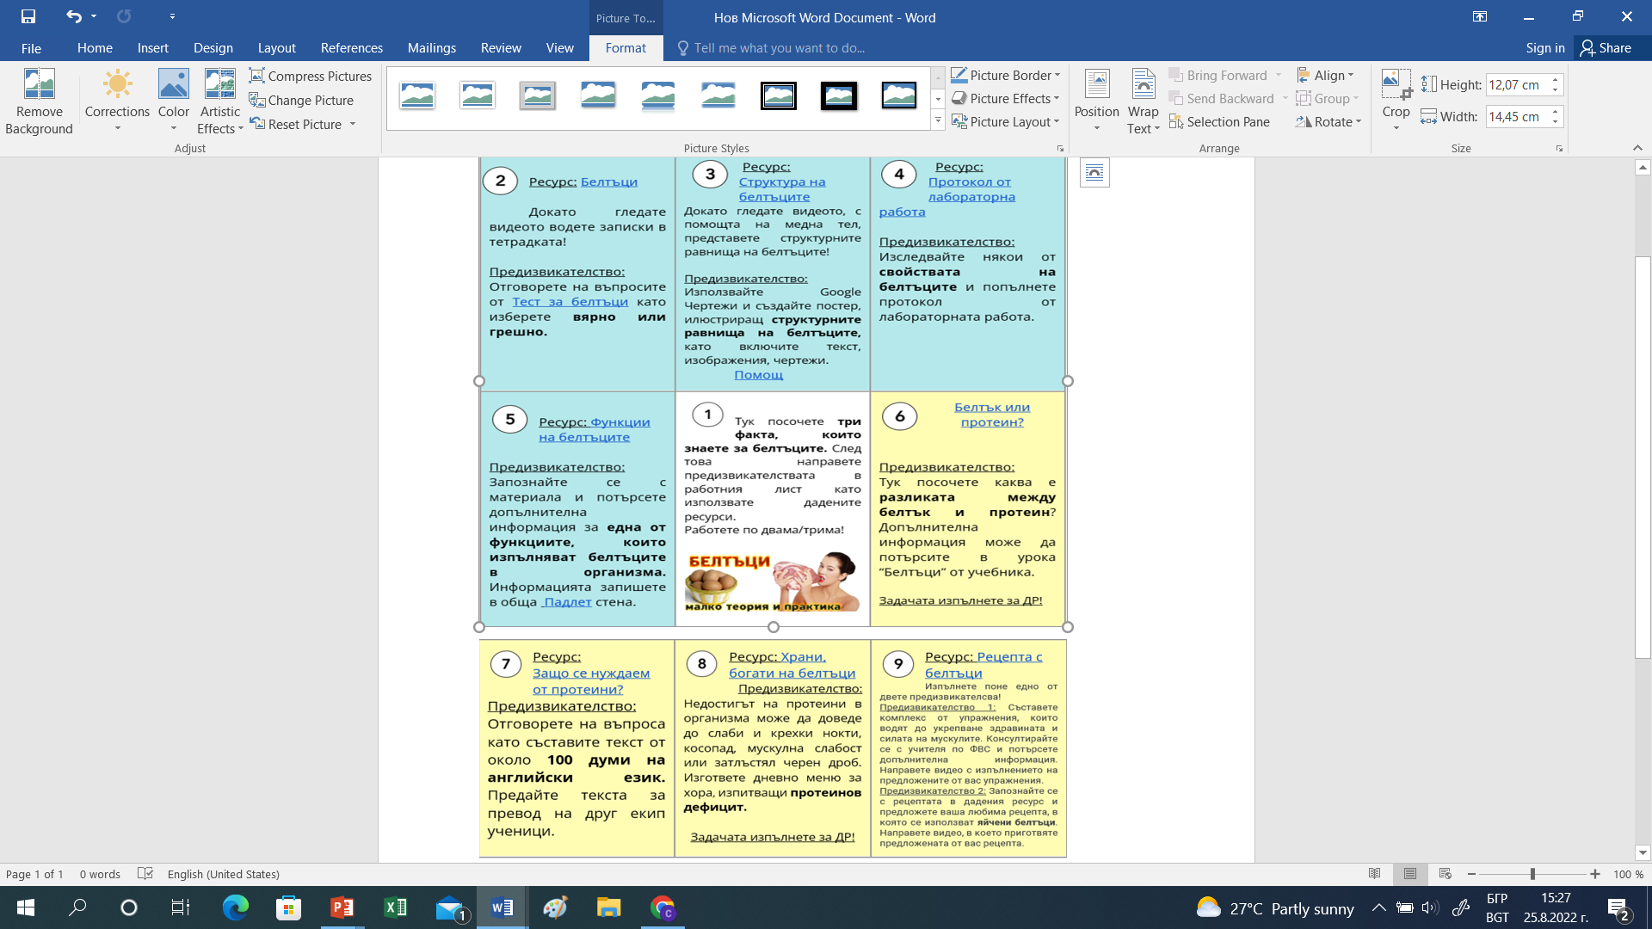

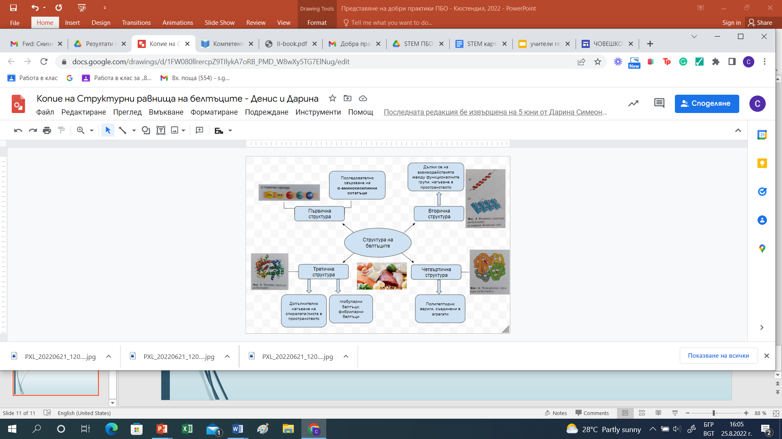
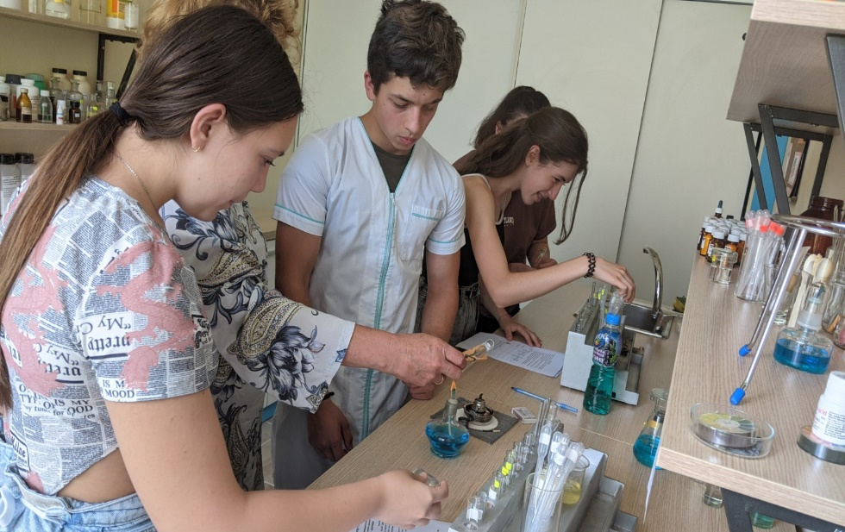
Интердисциплинарни уроци
(реализирани в учебната практика)
Белтъци (9 клас)
химия и опазване на околната среда
биология и здравно образование
английски език
физическо възпитание и спорт
Notes:
After consulting a variety of sources, you will need to narrow your topic. For example, the topic of internet safety is huge, but you could narrow that topic to include internet safety in regards to social media apps that teenagers are using heavily. A topic like that is more specific and will be relevant to your peers. Some questions to think about to help you narrow your topic:
What topics of the research interest me the most?
What topics of the research will interest my audience the most?
What topics will the audience find more engaging? Shocking? Inspiring?

Slide 9
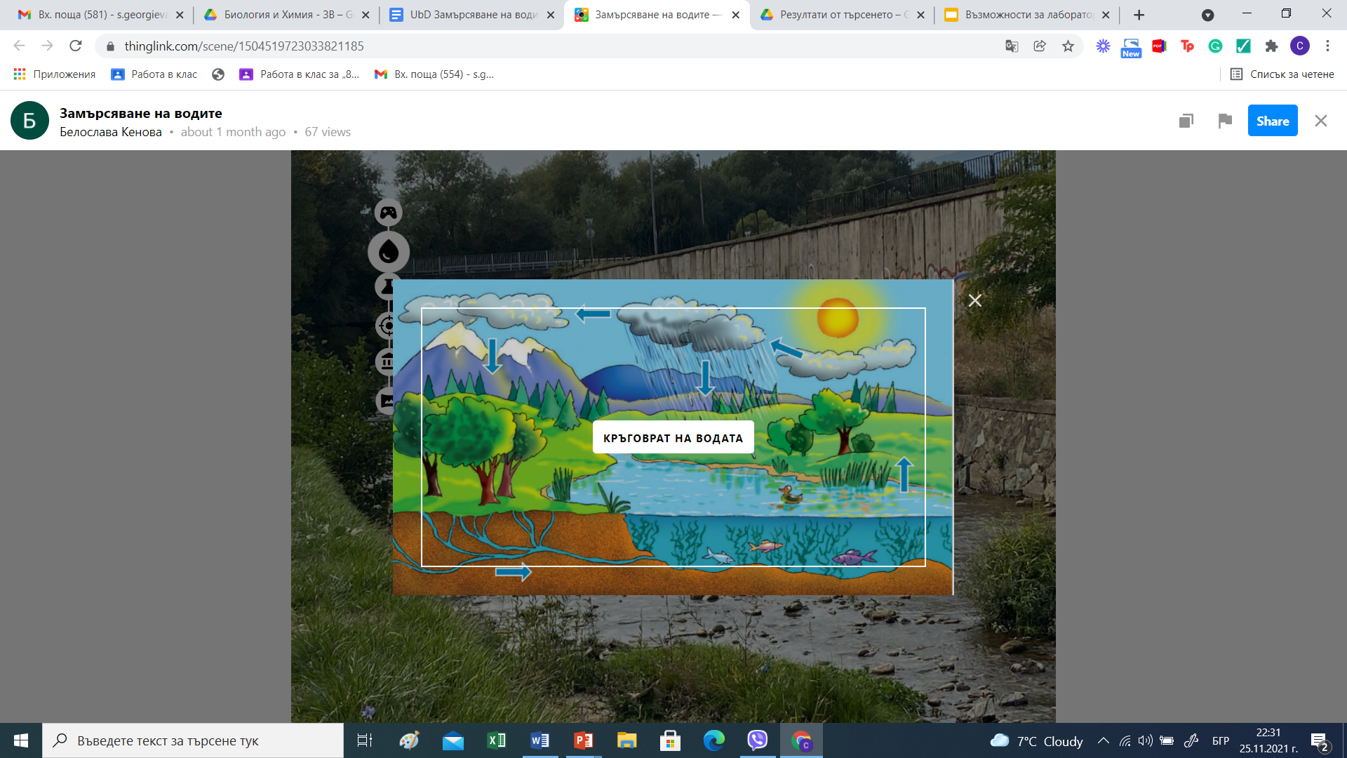
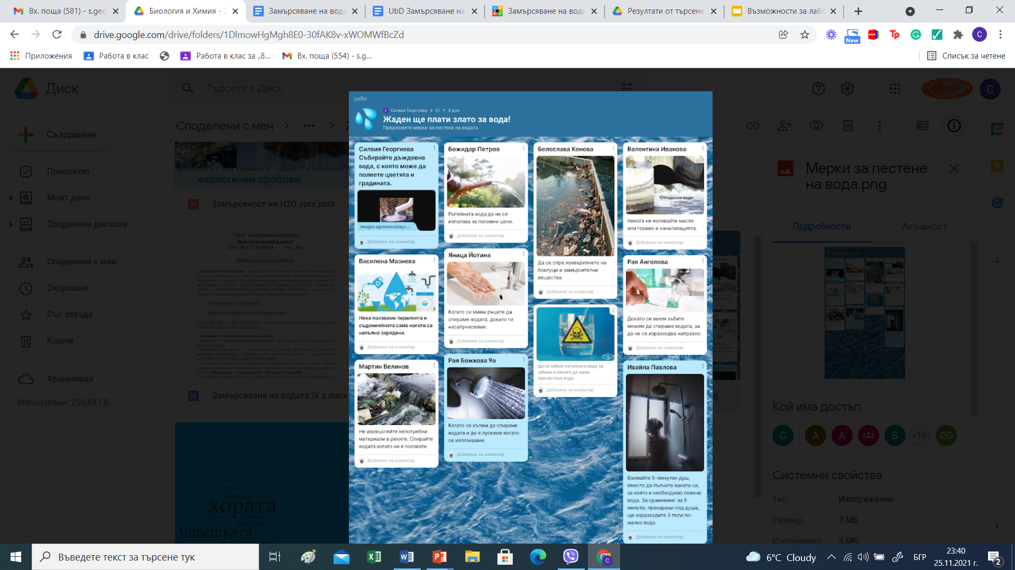
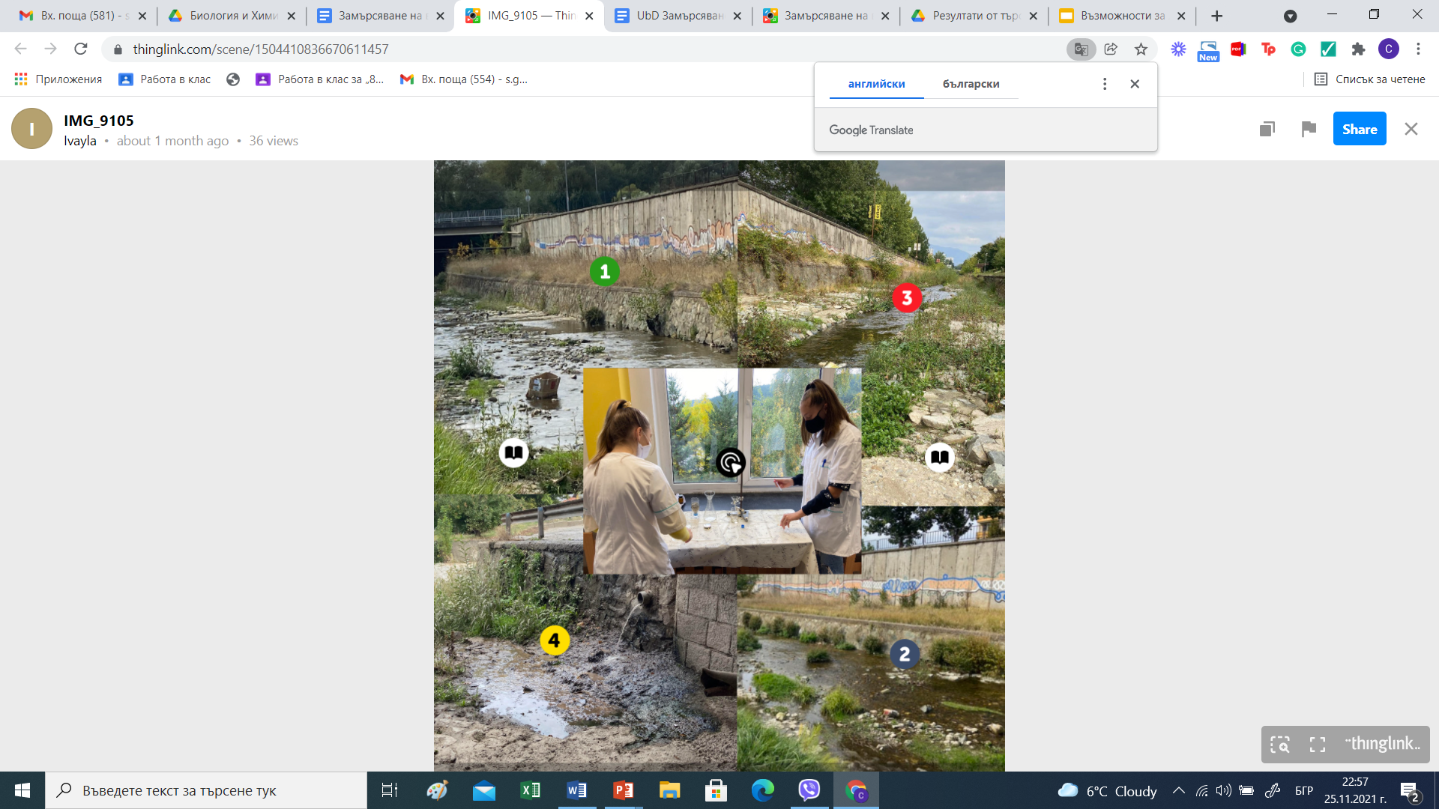
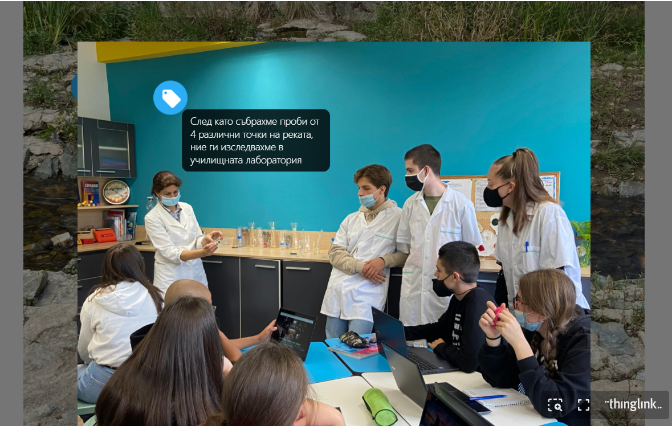
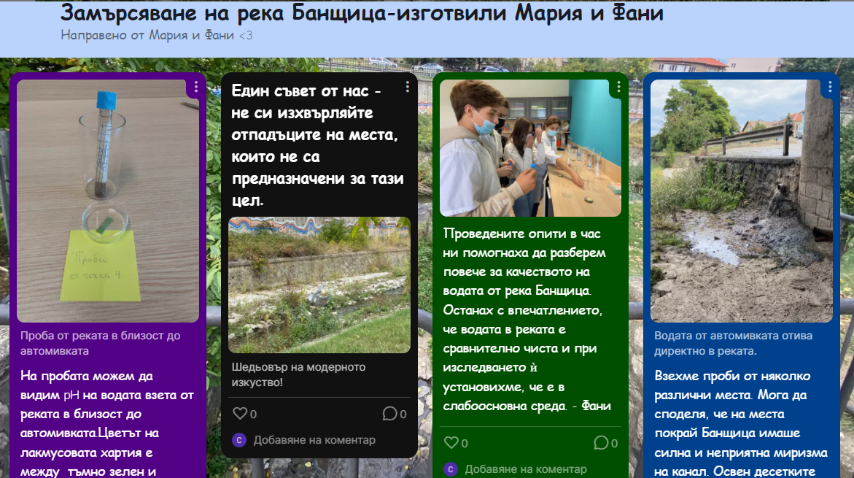
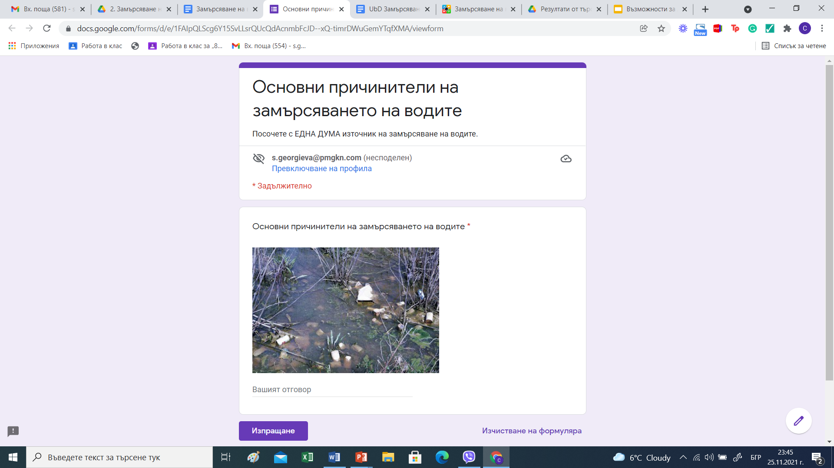
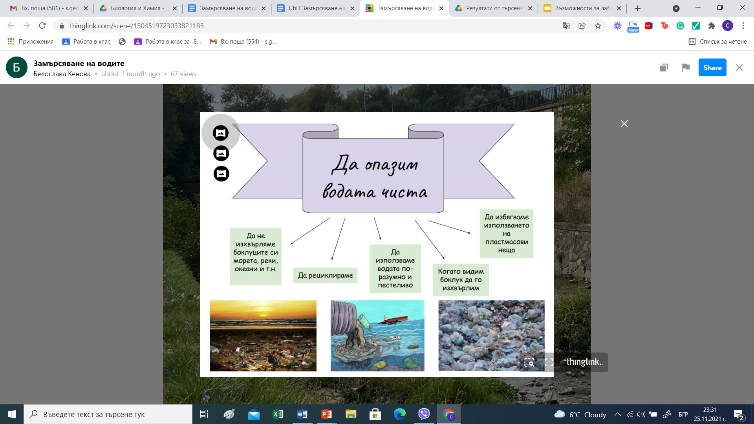
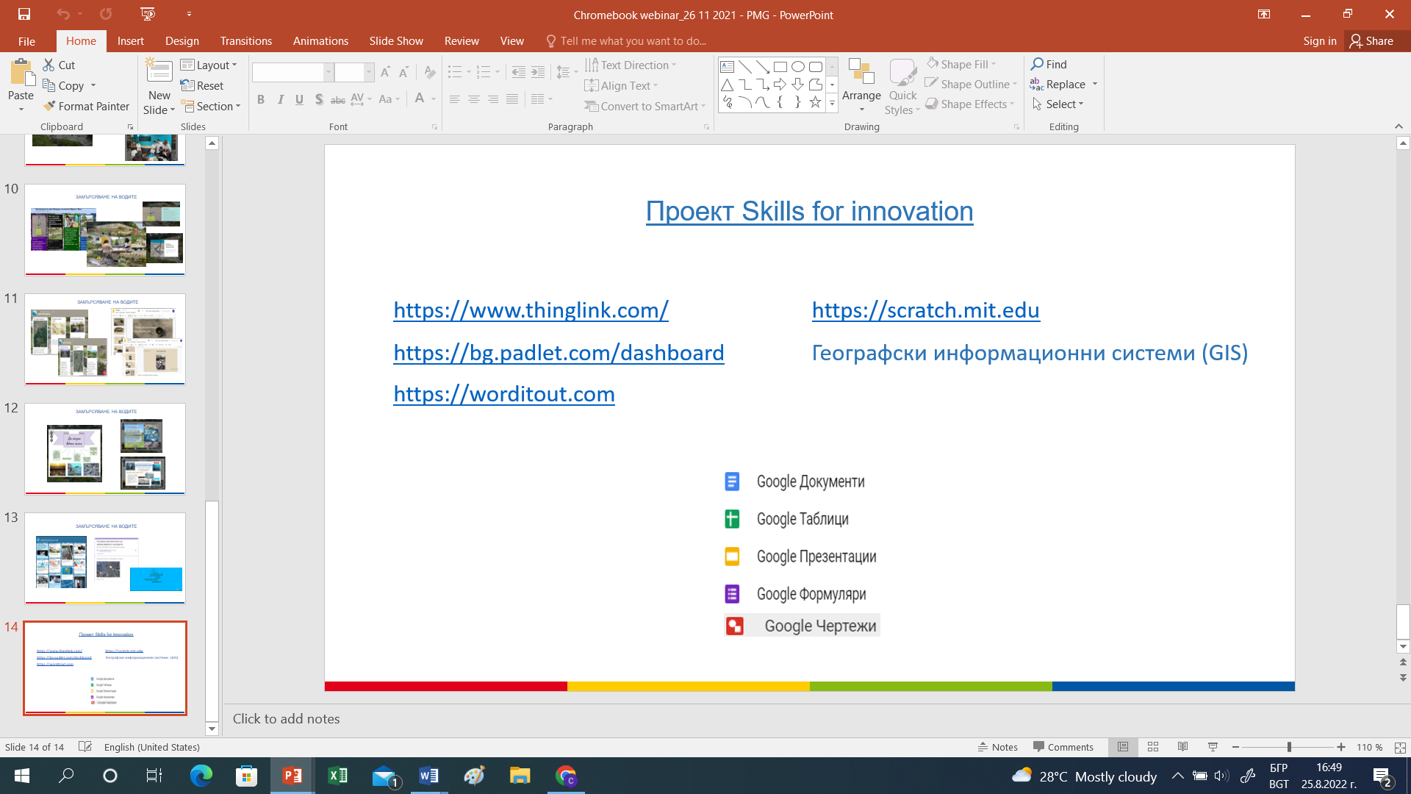
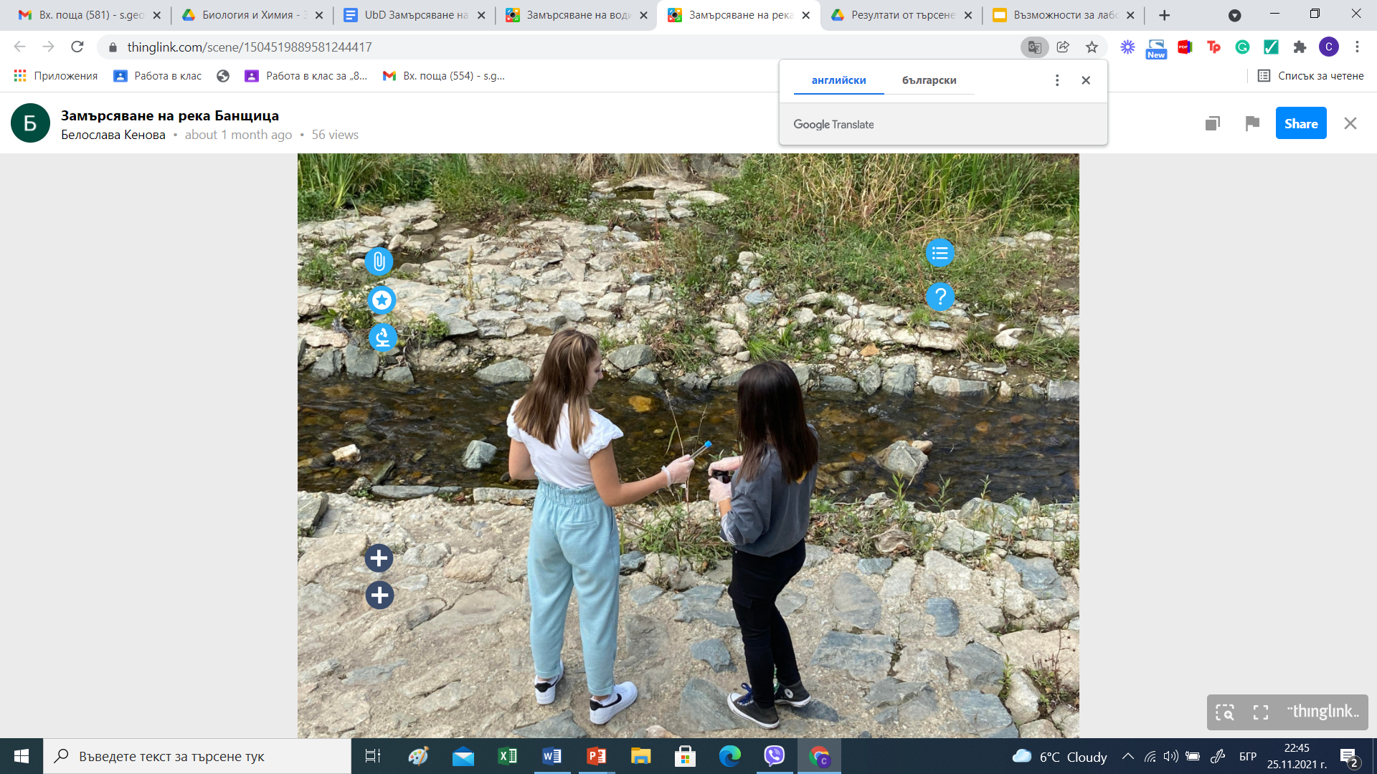
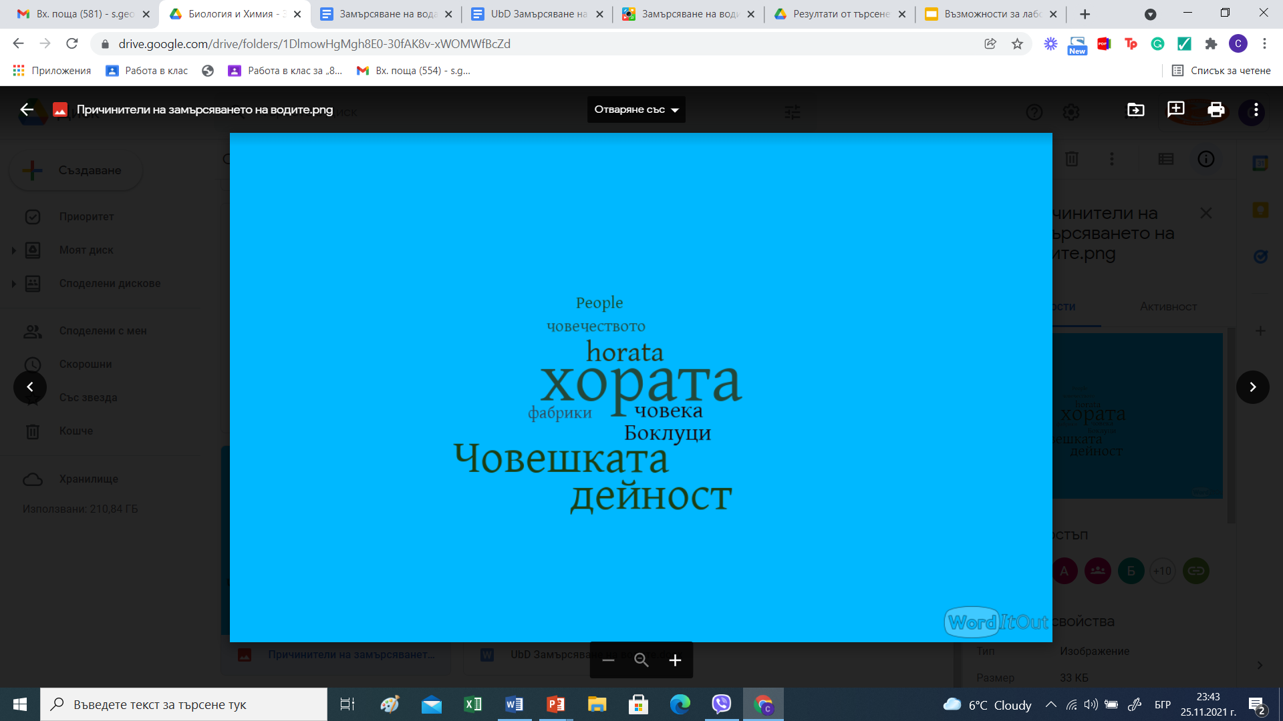
Интердисциплинарни уроци
(реализирани в учебната практика)
Замърсяване на водите (10 клас)
биология и здравно образование
химия и опазване на околната среда
информационни технологии
география и икономика
история и цивилизации
философия

Slide 10
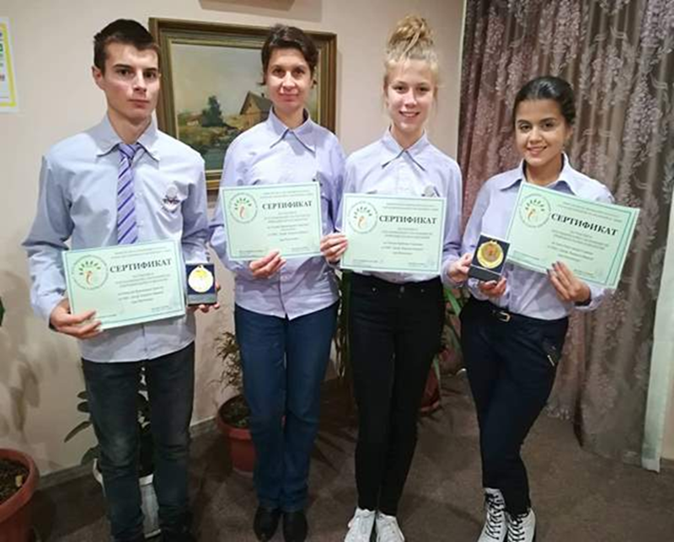

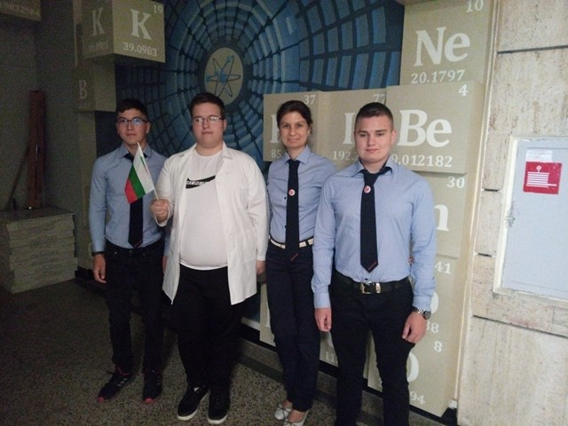
Интегриране на знания, умения и отношения от една предметна област в друга.
Поставя се акцент върху практическата значимост на ученето, създава се тясна връзка между теорията и практиката.
Стимулират се креативността и иновациите, повишава се интересът на ученика към учебната работа.
Поставя се фокус върху резултата като комплекс от умения за действие в различни нестандартни ситуации.
Осъзнаване смисъла от придобиването на знания и умения.
Реализира се предпочитана от учениците личностна изява.
Резултатите

